Slide 1
Breather
Katrina Machado

Slide 2
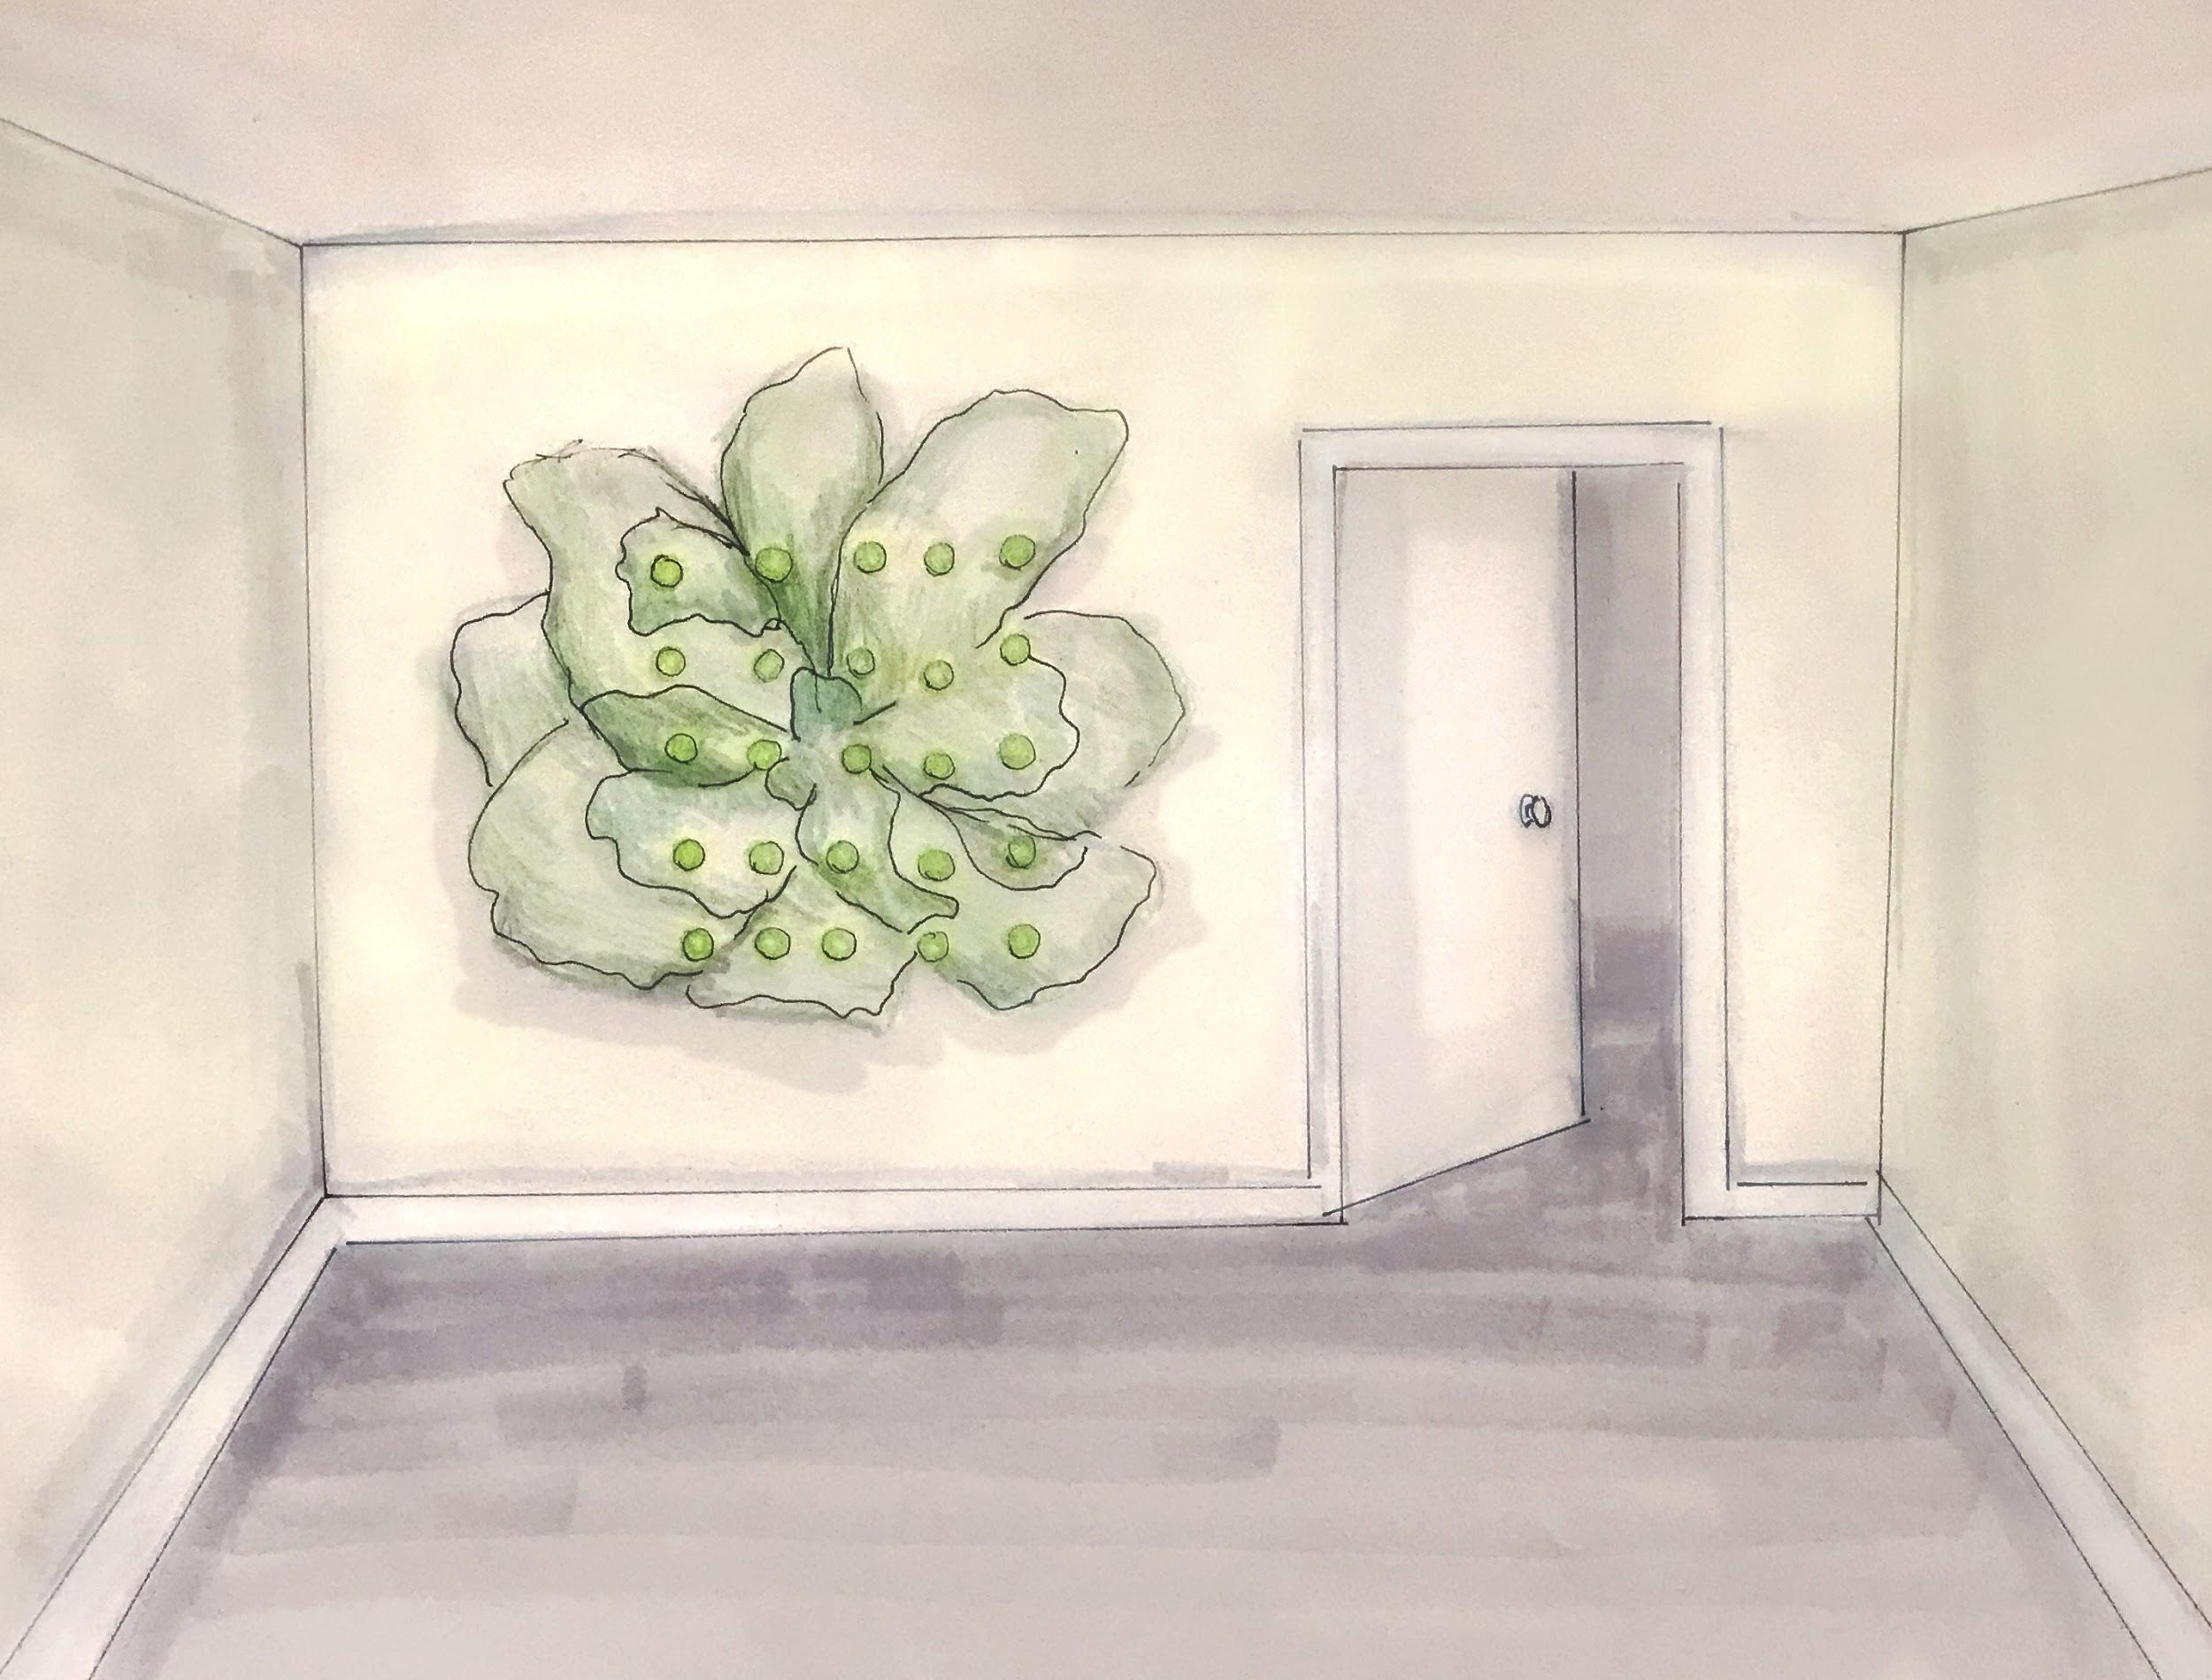
Installed in an office or industrial building, Breather is intended to re-center its viewers in their environments and selves through long paced breaths.
Evoking natural elements, it offers meditation and calm in an otherwise sterile and fast-paced working environment.

Slide 3


Slide 4
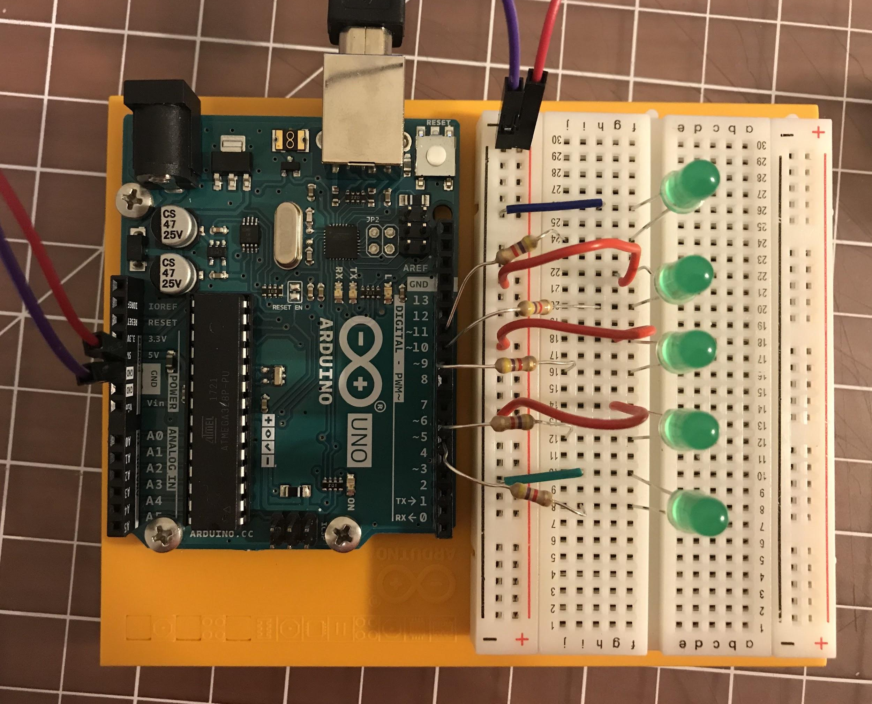
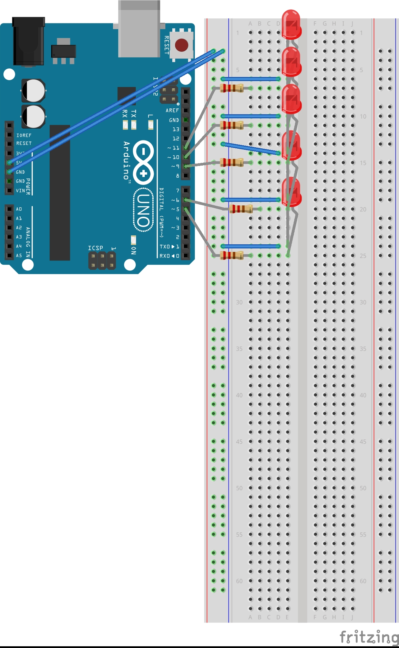
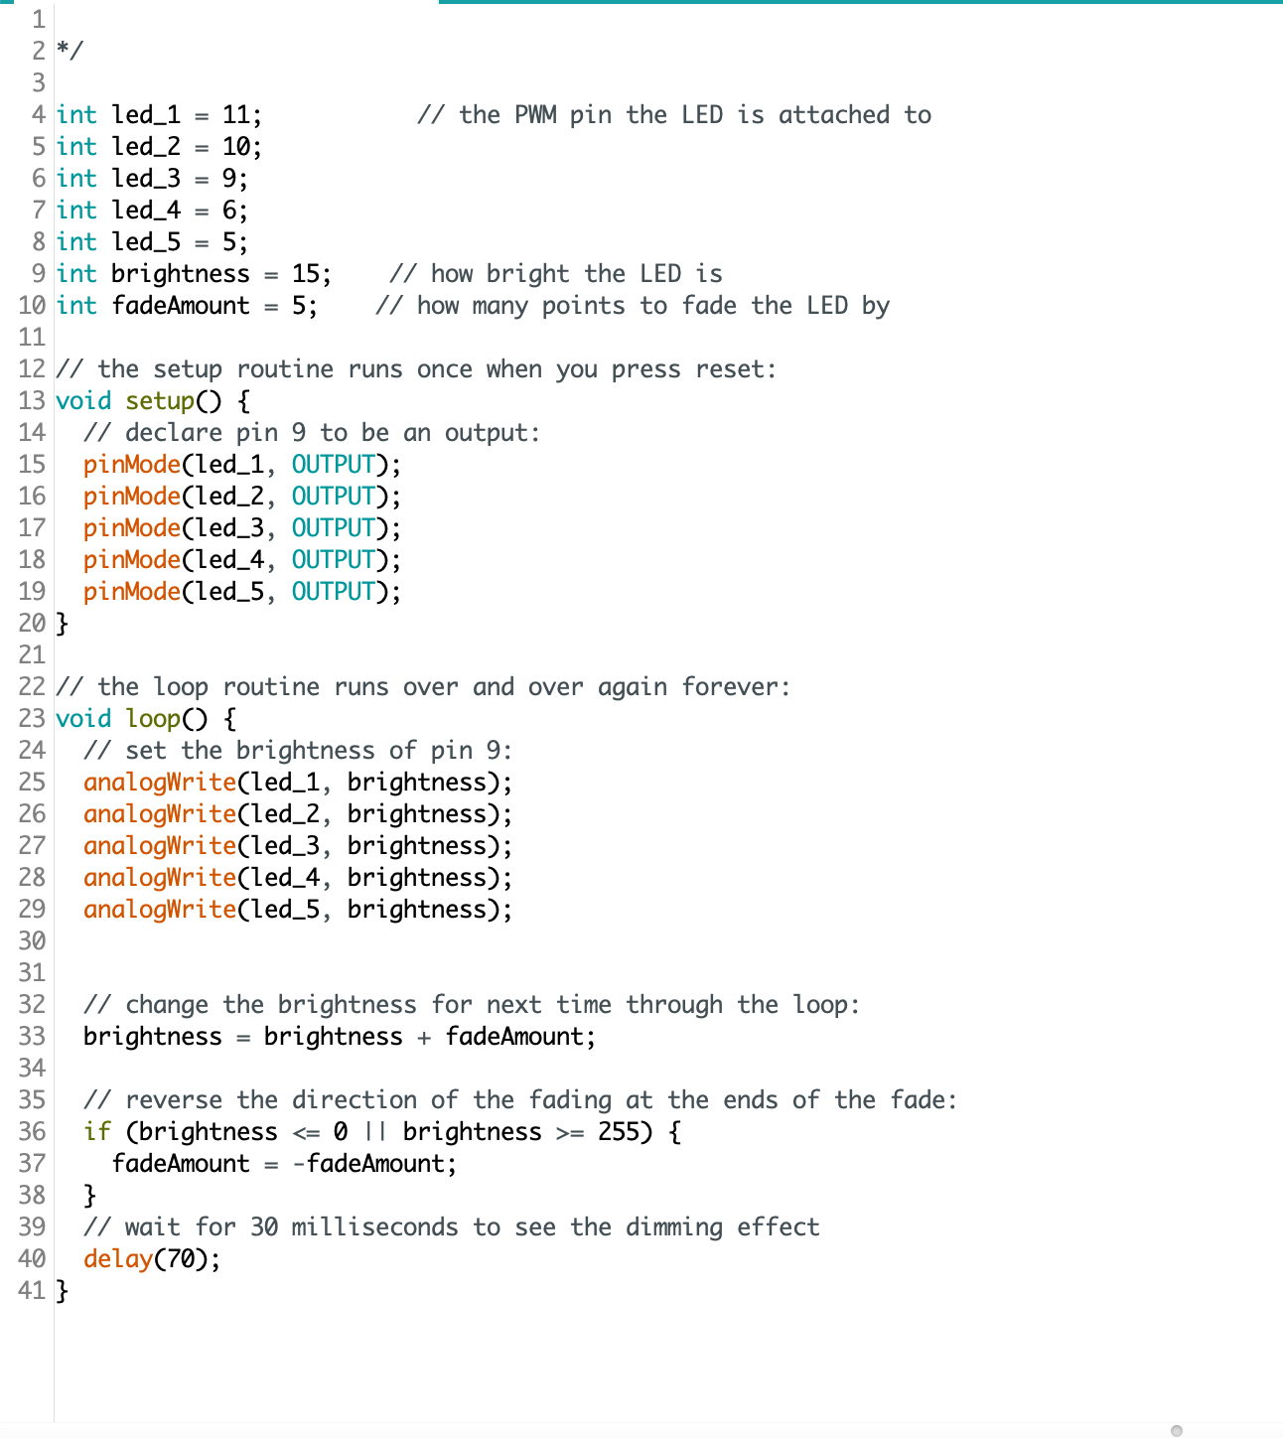
Building on the Fade lesson/process

